Slide 1
EC 544 Challenge 1
Group 01
Ziyu He, Yang Ming, Muyun Yan, Jingjing Zhu

Slide 2
Presenter for this challenge
 | Ziyu He | Yang Ming | Muyun Yan | Jingjing Zhu
Challenge 1 |  |  |  | Presenter
Challenge 2 |  |  | Presenter
Challenge 3 |  | Presenter
Challenge 4 | Presenter
Challenge 5 |  |  |  | Presenter
Challenge 6 |  |  | Presenter
Challenge 7 |  | Presenter
Challenge 8 | Presenter
Notes:
Photos from sports.yahoo.com

Slide 3
What did each of us do for this challenge?
 | Ziyu He | Yang Ming | Muyun Yan | Jingjing Zhu
Link circuit | 😁 | 😁 | 😁 | 😁
Configure Xbees | 😁 |  | 😁
Search Info. | 😁 | 😁 | 😁 | 😁
Code-Arduino |  | 😁 |  | 😁
Code-baseStation | 😁 |  | 😁 | 😁
Code Review & Optimize | 😁 | 😁 | 😁 | 😁
PPT | 😁 | 😁 | 😁
Video
Github | 😁 |  |  | 😁
Presentation |  |  |  | 😁
Notes:
Photos from sports.yahoo.com

Slide 4
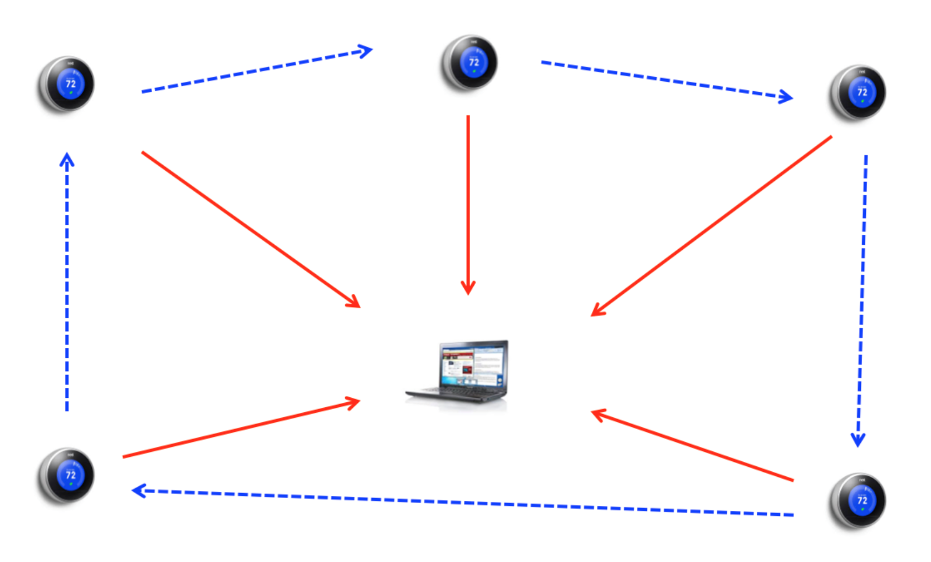
Sketch of Design Concept
Use 4 XBees to communicate with each others , one of them is coordinate while other three as router.
Using Polling to check for
its readiness or state.

Slide 5
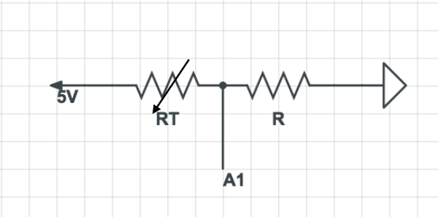
Calculating Temperature
1. Calculating Thermistor Resistance from voltage-divider equation
Rt=((voltagePower-voltageValue1)*Rs) /voltageValue2
2.Calculating the Temperature
Using Steinhart-Hart equation to map thermistor resistance to sensed temperature.

Slide 6
Components Used
software packages：Arduino IDE, Node.js, http, express, node serialport, socket.io
Techniques: Mesh Networking, RF Wireless Communication
Hardware : Arduino, XBee

Slide 7
Challenges Encountered and Resolved
Challenges Encountered | Resolved
Xbee’s damage. | Recover it respect to its own model type.
Unable to distinguish 4 Xbee from each other. | Give a head containing the ID of Xbee router in each Xbee’s emitting data.
Unable to “talk” to coordinator. | Using serial port package to read the data from ports.
How to deal with the situation if one of Xbee router got unexpected damaged. | Modify the function that the coordinator will alert if one router’s data has missed.

Slide 8
Other qualities
Challenges | Resolved
Robustness to added or dropped devices. | Modify the variable and time period for the polling loop in coordinator’s function to adapt the different number of routers.
Evidence of scalability to 1000s of devices. | AR in Xbee’s configuration suggest that if our coordinator “talk to” routers one by one every 1 sec, we are able to talk to as most 2550 routers. In this situation, we may let each router delay for 1000 milliseconds(1 sec).
Demonstrated effort to calibrate sensors. | Using the same pair of fingers to touch the thermometer and thermistor simultaneously, check if the temperature is almost the same.

Slide 9
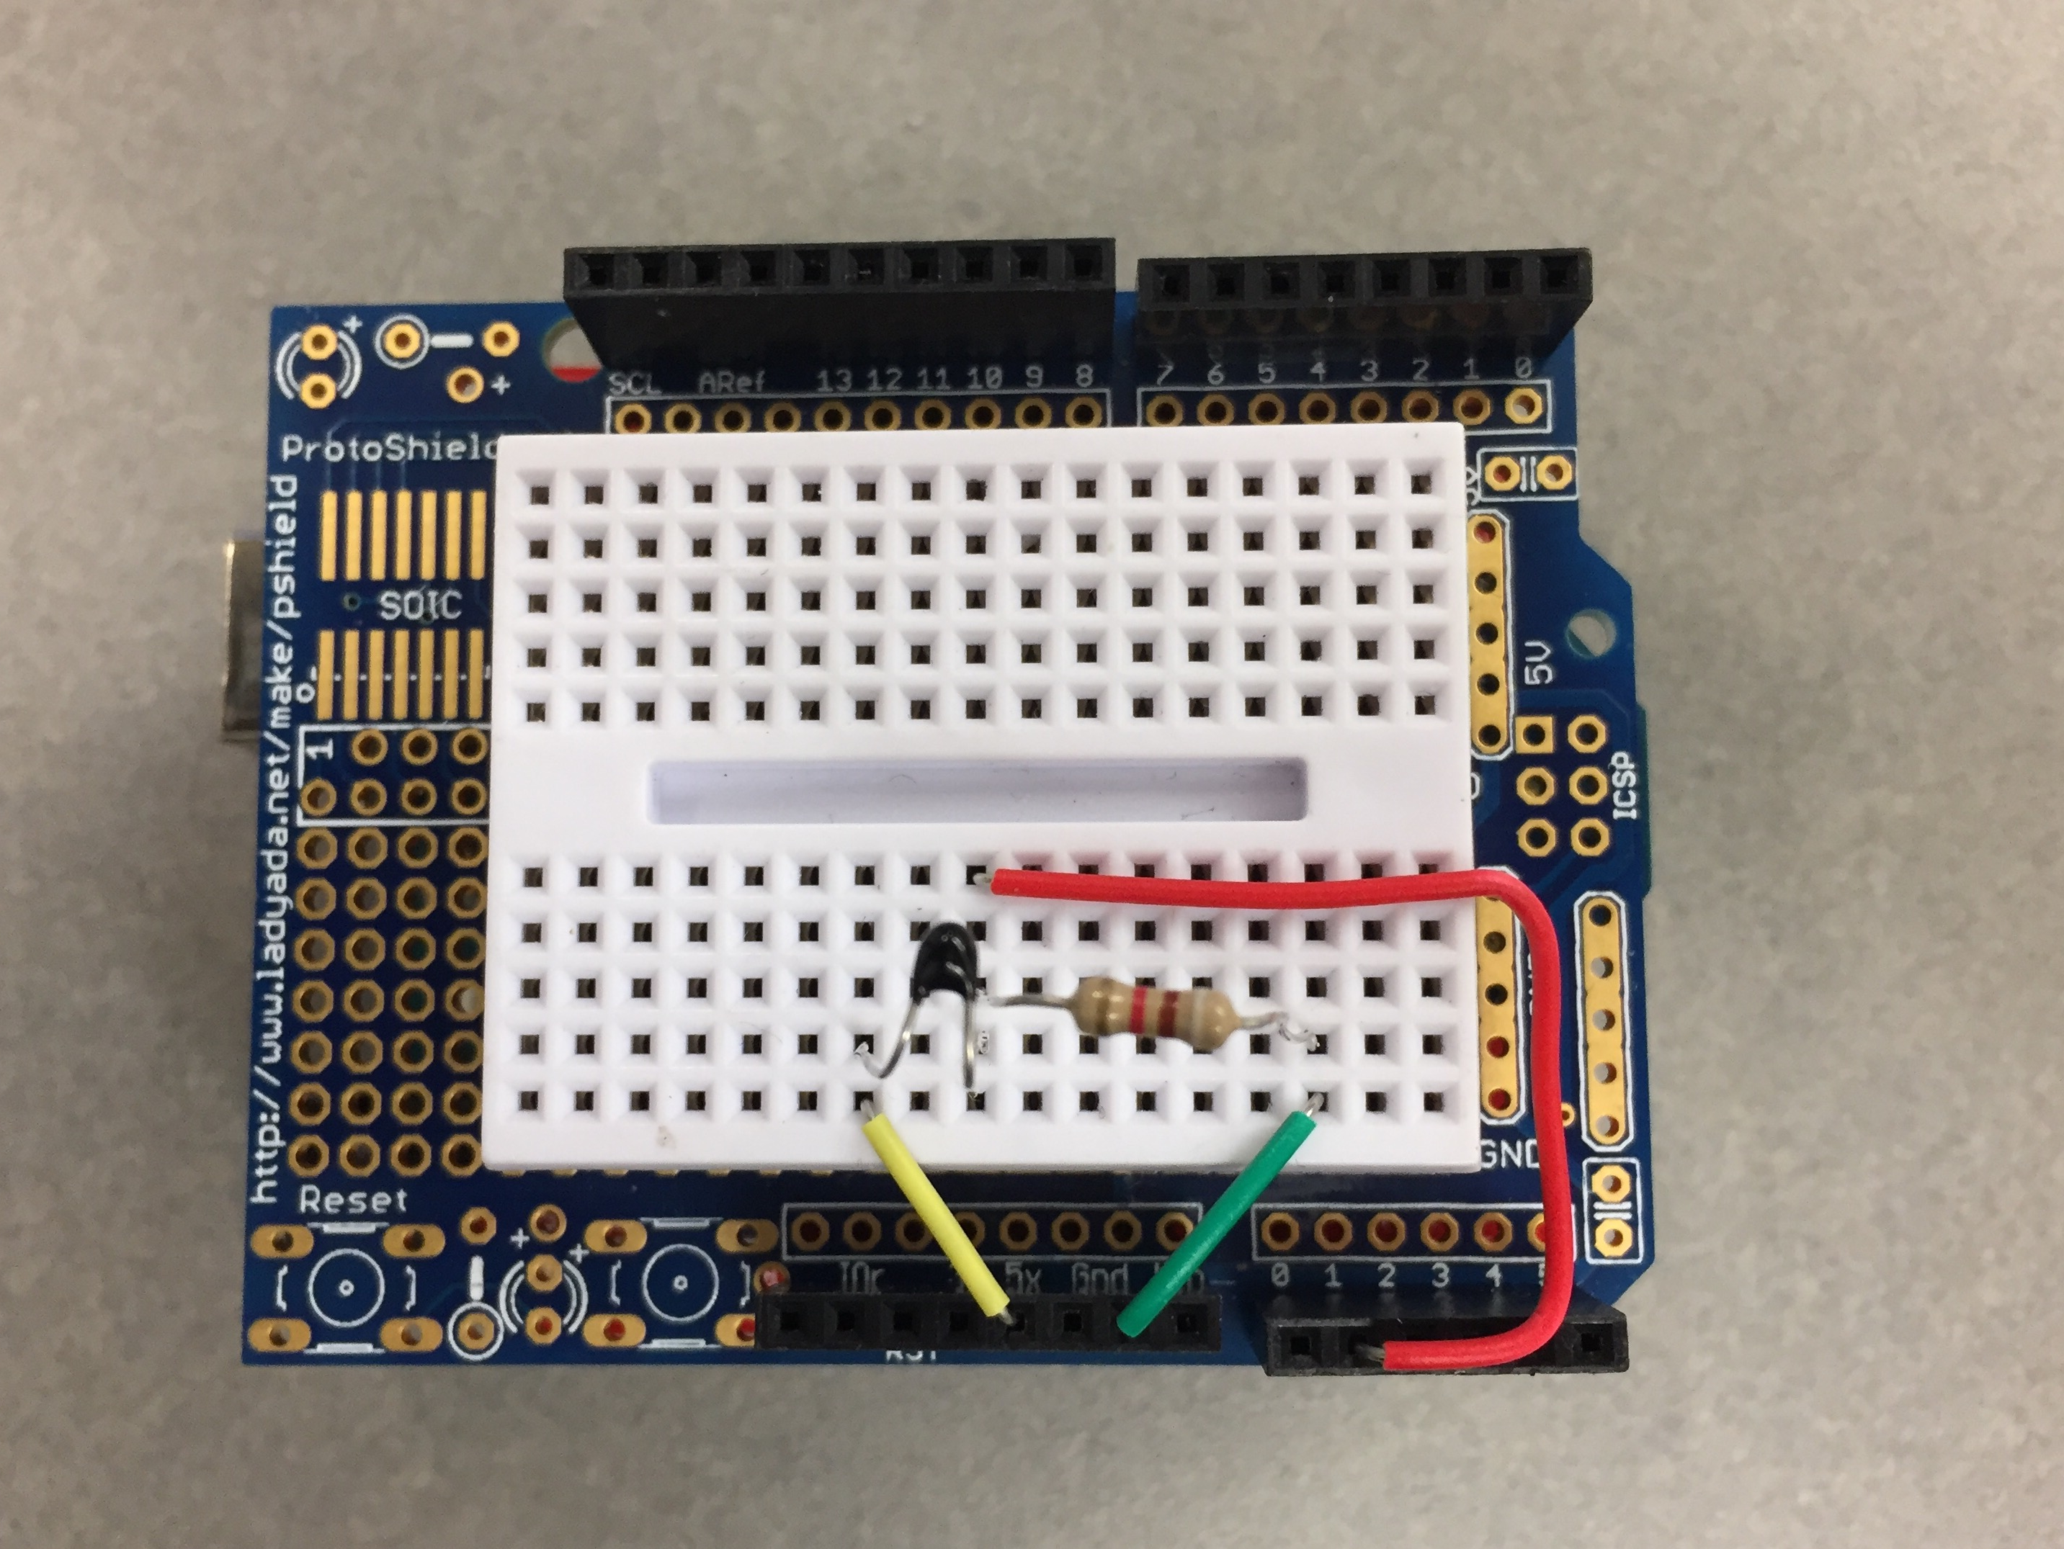
Photos of Developed System
Rt
Rs
VoltageValue2
VoltageValue1
5V | VoltagePower

